Slide 1
Digital Modes Discussion
05/09/2019

Slide 2
Digital Mode Agenda
Why Digital?
Equipment requirements
Examples of Modes and Interactive Demos (Bring your stuff)
Digital Net Planning
Reading Materials

Slide 3
Introductions
Aaron Jones – AG7GK first licensed in 2016 as KI7DUK
Summary of group experience
General / Extras
Technicians
Digital now?
Digital in the future?
EMCOMM
DX

Slide 4
Why Digital?
CASE FOR DIGITAL EMCOMM
Voice example using NTS Traffic Protocols:
St. John's, prepare to copy.
Tag 176003, female, 20 - 30, transport helo, red.
Now imagine having to transmit and verify that 20, 30, 50 times or more.
How long would that take?
Not including phonetics, repeats, fills, breaks, and confirmation...
17 minutes.
Using a digital mode, we can transmit that data in a fraction of the time... and verify it!
2 minutes 28 seconds.
Maybe you just don’t feel like talking to someone!

Slide 5
Notes:
Many locations any licensee can play with digital modes

Slide 6
Bandwidth
Note: Not “necessary bandwidth” as defined by ITU
Notes:
Not “necessary bandwidth”

Slide 7
Equipment
Computer OR Tablet / Phone
Cables
Radio with APRS
GPS
RADIO
TNC or Soundcard
Pactor Modem (In case of Network modes like Winlink)

Slide 8
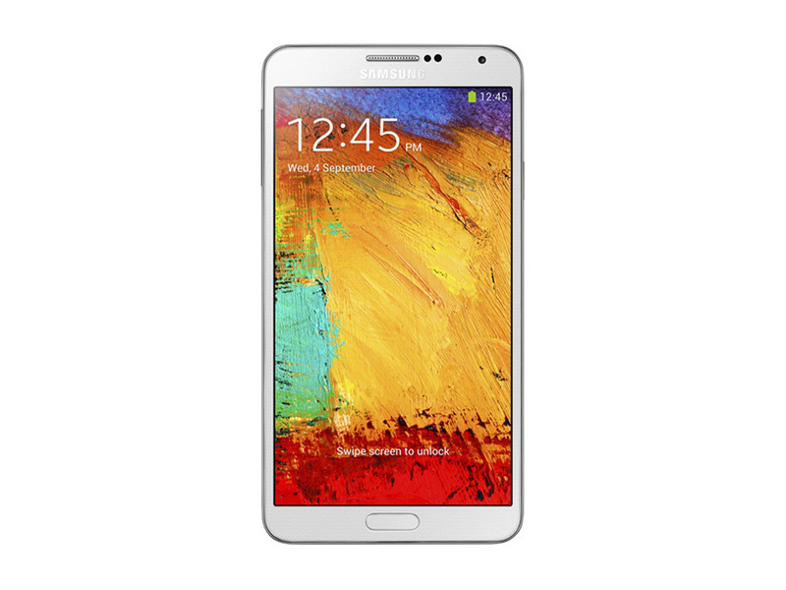
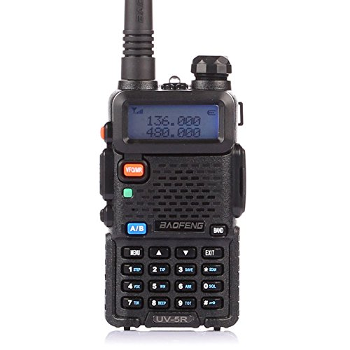
HT Acoustical Coupling
http://www.w1hkj.com/vk2eta
Tablet / Phone / Computer
Apps:
Android SSTV
AndFLMSG
Droid PSK
HT with HT specific cables
Baofeng HT
APRS Specific Setup
HT
MOBILINK TNC and Cable
APRS Droid

Slide 9
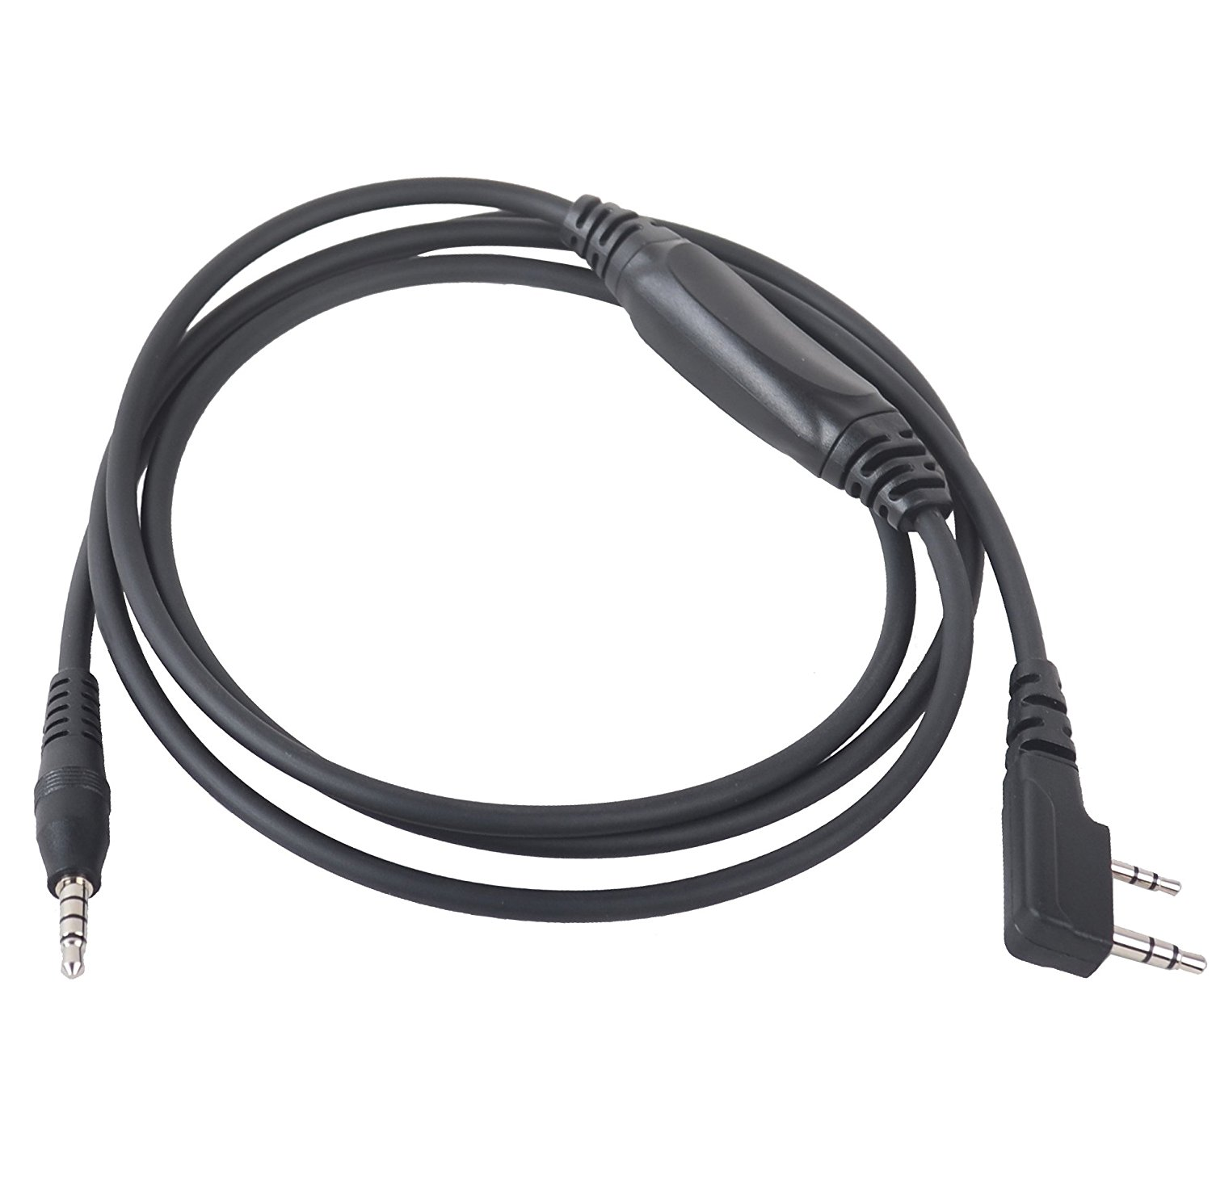
HT / Audio Cable
Tablet / Phone / Computer
Apps:
Android SSTV
AndFLMSG
Droid PSK
HT with HT specific cables
Baofeng HT
Baofeng BT Tech APRS Cable using VOX PTT OR
Custom Audio interface cable to trigger PTT
APRS Specific Setup
HT
MOBILINK TNC and Cable
APRS Droid

Slide 10
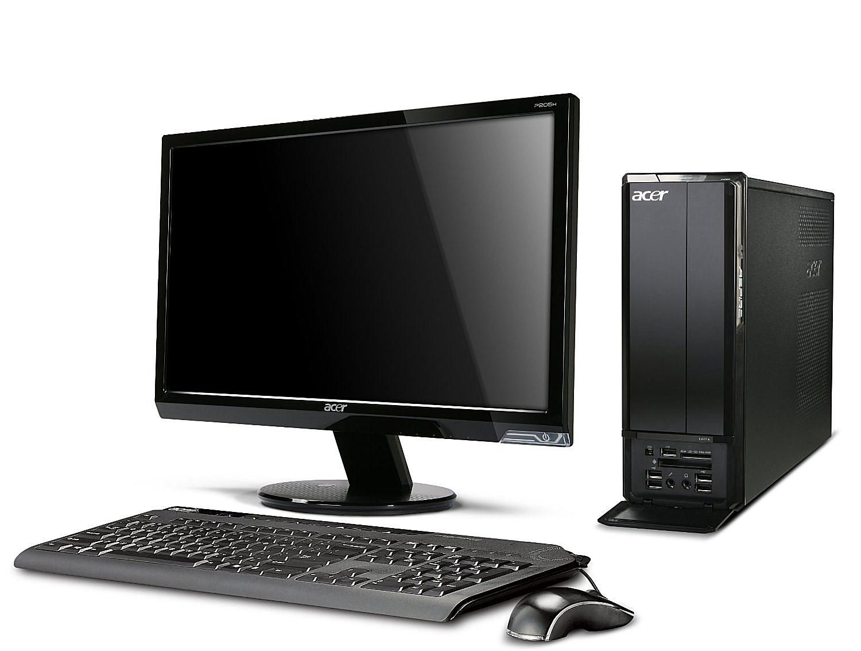
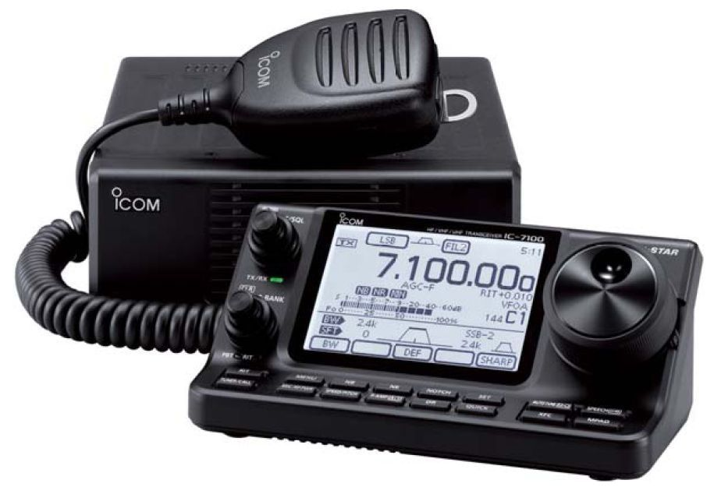
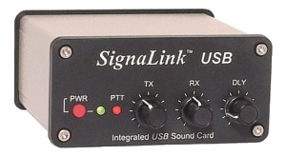
Basestation
Computer / Tablet
Soundcard either built in or USB
Apps:
MMSSTV
FLDIGI- FLMSG-FLRIG
WSJTX
WSJT-X JTalertX
Bastation
Any Antenna – Mag Loop, Dipole, Vertical, anything to get a signal in and out

Slide 11
Warning about Duty Cycle
Reduce your power!
Unlike SSB, these modes either run at 100% duty cycle, or use multiple tones sensitive to intermodulation distortion!
Be kind to your finals!
Keep peak power out well below key-down CW maximum to minimize distortion.
Keep ALC to zero
Turn off speech processing or compression

Slide 12
Software
WSJTX – used for FT8, JT Modes, WSPR, and Meteor Scatter
MMSSTV – Used for Slow Scan TV
FLDIGI – Many modes and options with companion software such as:
FLAMP - Amateur Multicast Protocol (One to Many Transmission of Files)
FLMSG – Message sending, one to many including CSV data, Text, Images, Radiograms, and many ICS related Emcomm forms
ANDFLMSG – Android version of FLMSG
Other FL related software
Winlink RMS Express
APRS Software (Many versions for all platforms)

Slide 13
Propagation Websites
PSKreporter.info: https://pskreporter.info/pskmap.html
Use the stats page to see what modes are happening: https://pskreporter.info/cgi-bin/pskstats.pl
Wsprnet for WSPR results; http://wsprnet.org/drupal/wsprnet/map OR alternative: http://wspr.aprsinfo.com/
Hamspots.net: https://hamspots.net/
APRS.fi: https://aprs.fi
Online listing of hosted SDR receivers, great for verifying your signal on voice OR digital: http://websdr.org/

Slide 14
NBEMS / FL “Suite”
Narrow Band Emergency Messaging System
http://www.w1hkj.com/NBEMS/NBEMS.ppt
Software (All free):
FLDIGI – Main application for mode selection, rig control, QSO’s
FLAMP – Application for sending files in chunks, allows for retries and relays of missing chunks
FLMSG – Your go-to application for sending text and forms (Radiograms)
ANDFLMSG – Android version
FLRIG – Rig control application if you have a CAT control interface to your RIG

Slide 15
NBEMS - Demo
FLDIGI Interactive Demo
ANDFLMSG on a tablet and Handheld using Acoustic Coupling

Slide 16
NBEMS - Demo

Slide 17
SSTV DEMO
A single image is converted to individual scanned lines and those lines sent as variable tones between 1500 and 2300 Hz
A color image takes about 2 minutes to transmit, depending on mode. Some black and white modes can transmit an image in under 10 seconds
Uses for Emcomm? Pictures of flooding, storms, damage, wellness checks, documentation.
Many options for PC, MAC, Linux, Android and IOS software

Slide 18
SSTV
SSTV Software “MMSSTV”
Captured on 145.500 Mhz VHF from International Space Station from Russian Cosmonauts celebrating 40 years in space
Fun mode for sending pictures and various software options for computer, Android, and IOS
Notes:
SSTV Image from International Space Station transmitted by Kosmonauts

Slide 19
JT Modes (JT65, JT9, FT8)
Origin: Created by Joe Taylor W1JT in 2003 for EME work
A way to have a QSO using a computer
A weak signal digital communications mode for Amateur Radio
A Multi-Frequency Shift Keying scheme employing Forward Error Correction with 65 tones
Bandwidth: 50-180 hz
Prevalence: Predominant modes for DX contacts
Equipment requirements: HF Radio, Soundcard(ext/int), Computer, Rpi can work, WS-JTX software, other options exist
Pros: Widespread, with FT8 very fast QSO’s, SNR resilience
Cons: Not conversational

Slide 20
JT Modes (JT65, JT9, FT8)
Exchange with TAIWAN
30 Meters
Very weak signal, BV1EK reported my signal at -18 SNR and I reported his at -14

Slide 21
FT8CALL New Software
New software being built TODAY
Uses FT8 Protocol but allows keyboard to Keyboard Conversational Style
Integrated with APRS to allow location updates and EMAIL-2 directed messages
Getting Popular but get ready to WAIT, very slow.

Slide 22
WSPR (Demo)
Origin: 2008 by Joe Taylor
The Weak Signal Propagation Reporter
An automated system designed for sending and receiving low-power transmissions to test propagation paths on the MF and HF bands.
The program can decode signals with S/N as low as -28 dB
Bandwidth: 6 hz
Antenna propagation at: http://wsprnet.org/drupal/wsprnet/map OR http://wspr.aprsinfo.com/
Equipment requirements: HF Radio, Soundcard(ext/int), Computer, Rpi can work, WS-JTX software, other options exist
Pros: Great for seeing where your signal is going
“WSPR is about 11 dB better than ear-and-brain CW.
“For most operators, the difference is more like 15 dB."

Slide 23
WSPR (Demo)

Slide 24
OTHER Digital “Systems”
APRS
VHF 144.39 MHz simplex
Utilizes “Digipeaters”
Requires TNC or software (Many options)
Good for short text messages
Map/ Location awareness
Winlink
VHF 145.01 MHz simplex and certain HF
Utilizes RMS packet and HF pactor stations
Requires TNC or software (RMS Express)
Email and File attachments
NBEMS/FLDIGI
Can utilize any VHF/UHF simplex freq, repeaters, HF
Can use “acoustic coupling” for interface but hardwired interfaces more reliable
Good for text messages, forms, files

Slide 25
Operational Flexibility

Slide 26
Winlink
Worldwide system for sending e-mail via radio
Provides e-mail from almost anywhere in the world.
Adopted for contingency communication by many government agencies
Used by infrastructure-critical NGOs such as International & American Red Cross, Southern Baptist Disaster Relief, DHS Tiered AT&T Disaster Response & Recovery, FedEx, Bridgestone Emergency Response Team, etc.
VHF and HF options
Hardware: Computer, TNC or Pactor Modem, RMS Express Software, Radio
Pros: Pactor is very fast for HF, reliable, has peer-to-peer options
Cons: Reliant on internet in normal operation, complexity

Slide 27
Winlink

Slide 28
APRS
Automatic Packet Reporting System
Original Developed in 1984 to Map Navy Positions, with availability of GIS in the 90’s became feasible for GPS integration
The system is based on the AX25 Packet protocol, and was developed by Bob Bruninga WB4APR, a senior research engineer at the United States Naval Academy.
North American frequency is usually 144.390, though operable at UHF, 6 meters and some HF
Mostly a one-to-many system, though there are some one-to-one applications
Public service and events, search and rescue, emergency services

Slide 29
Digital Net Discussion
Interest
Every Sunday Night around 8:45 PM on 145.550 mhz using MFSK64 Mode
Examples
Goals
Netiquette
Lessons Learned
HF and VHF?

Slide 30
Useful Websites
Comprehensive Guide to NBEMS / FLDIGI, equipment setup, instructions, etc: http://gblakesl.net/ARES/Basic-NBEMS-Workshop.pdf
Presentation on Winlink: http://www.philsherrod.com/Winlink/Winlink_RMS_Express.pdf
Excellent Presentation on NBEMS and FLDIGI: https://www.jeffreykopcak.com/drive/ham_radio/digital_modes/vhf_uhf_nbems_an_introduction_using_fldigi_and_flmsg_presentations/vhf_uhf_nbems.pdf
Presentation on JT Modes: http://www.informationtechnologies.com.au/files/JT65%20Presentation.pdf
WSPR Presentation: https://www.powershow.com/viewht/1a4552-ZDc1Z/What_is_WSPR_powerpoint_ppt_presentation
Meteor Scatter Introduction: Link

Slide 31
More Useful Websites
APRS: http://www.aprs.org/APRS-mobile.ppt
A PRACTICAL EVALUATION AND COMPARISON OF SOME MODERN DATA MODES: http://www.qsl.net/zl1bpu/MFSK/datmodes2.pdf
ARRL presentations on NBEMS (Narrow Band Emergency Message System) with FLDIGI
http://www.arrl.org/files/file/On%20the%20Air/Tutorials/Introduction_to_NBEMS_ARRL.pdf
http://www.arrl.org/files/file/On%20the%20Air/Tutorials/Advanced_NBEMS_3_0.pdf
http://www.w1hkj.com/NBEMS/NBEMS.ppt
Digital Mode Comparisons from FLDIGI Help files: http://w1hkj.com/FldigiHelp-3.21/Modes/Compare.htm
Signal ID Wiki – listing of all digital signals, explanations, samples:
https://www.sigidwiki.com/wiki

Slide 32
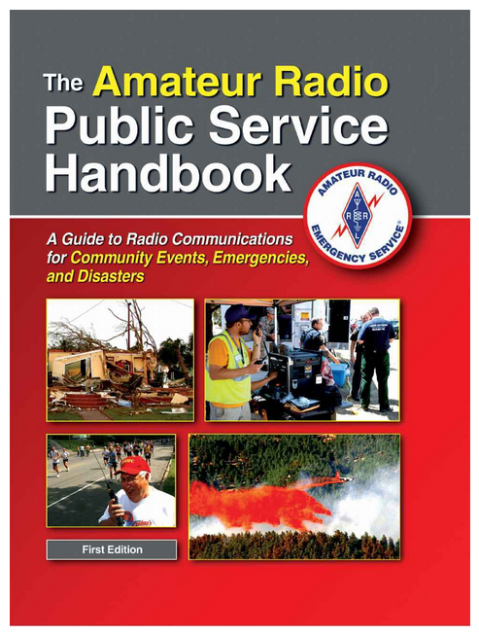
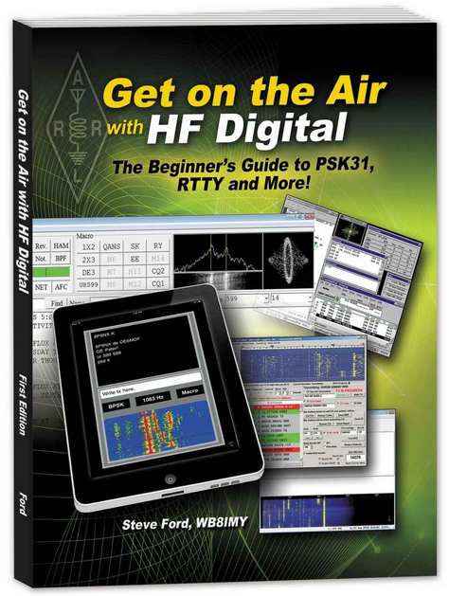
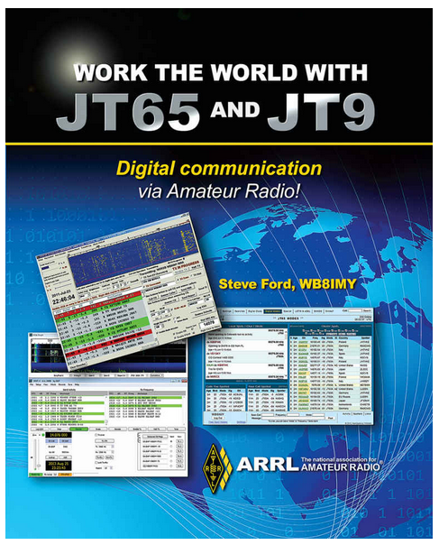
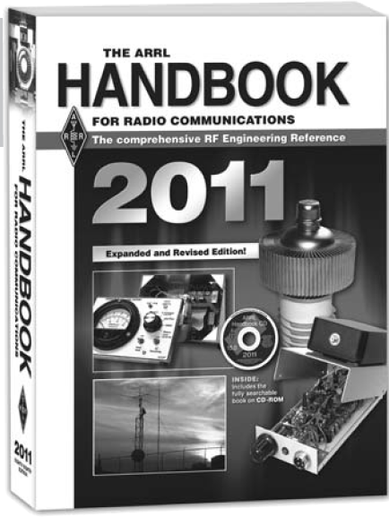
Nerd Reading

